Slide 1
Chaos Engineering
Implementing chaos engineering in spring boot applications

Slide 2
Agenda
What is Chaos Engineering?
Principles of Chaos Engineering
OpenSource Tools

Slide 3
What is Chaos Engineering?
Chaos Engineering is the discipline of experimenting on a distributed system inorder to build confidence in the system’s capability to withstand turbulent conditions in production.
Chaos Engineering is a discipline that directly addresses System Availability and affects:
People and Culture
Applications
Platforms
Infrastructure

Slide 4
Principles
Build a hypothesis around a Steady State behaviour
Vary Real World Events
Run Experiments in Production
Automate experiments to run continuously
Minimize the blast radius

Slide 5

Open-Source Tools
For Chaos Experiments

Slide 6

Chaos Monkey
Developed by Netflix as part of the Simian Army to test the resilience and reliability of distributed systems.
It deliberately introduces failures and disruptions in a controlled manner to ensure systems can withstand unexpected issues.
It randomly terminates instances or services to simulate outages.
Helps identify weaknesses and ensures that failover mechanisms and redundancy are effective.
Integrated into the deployment process to consistently test the system.
This Photo by Unknown Author is licensed under CC BY-SA

Slide 7
Chaos Gorilla
A tool developed by Netflix as part of the Simian Army, designed to test the resilience of entire availability zones within a cloud infrastructure.
To simulate large-scale failures and ensure that systems can handle the loss of an entire data center or cloud zone.
Randomly terminates all instances within a single availability zone.
Assesses the system’s ability to maintain functionality and recover from the loss of a complete zone.

Slide 8
Chaos Kong
Developed by Netflix to simulate failures across multiple AWS regions, designed to test the resilience of global distributed systems.
To ensure systems can handle the simultaneous loss of multiple regions and maintain overall service continuity.
Randomly terminates instances or services across multiple AWS regions.
Assesses the system’s ability to remain operational and recover from significant disruptions affecting multiple geographic areas.

Slide 9
Other OpenSource Tools
Latency Monkey - to simulate network latency and performance issues within distributed systems.
Facebook Storm - for stress testing and simulating large-scale failures in distributed systems.
AWS Gamedays - interactive, hands-on events where teams compete in a controlled environment to solve real-world cloud architecture challenges and address failure scenarios.

Slide 10
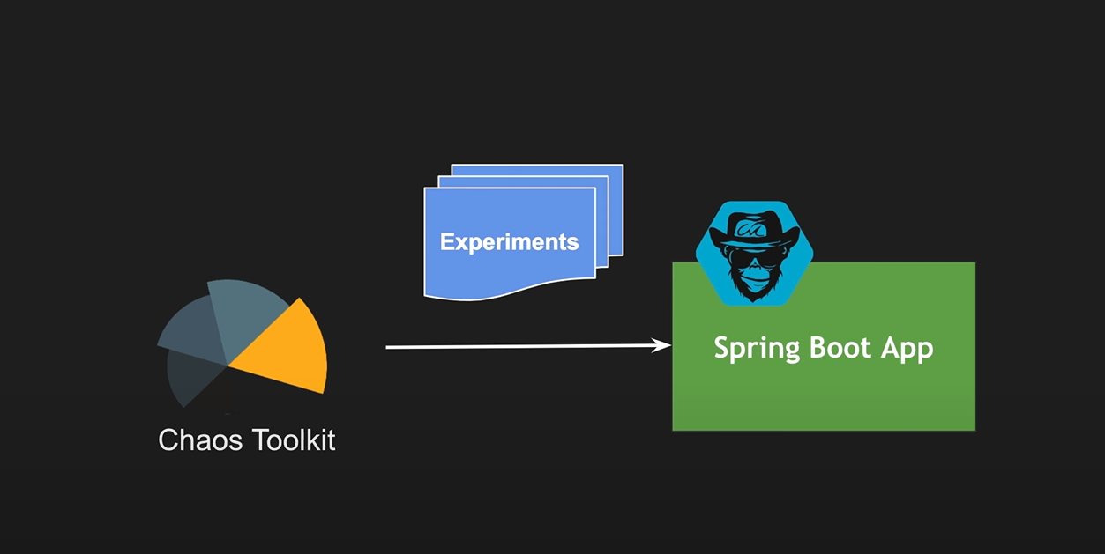

Slide 11

Thank you!

